Slide 1



Day-2
Machine Learning
Marvel Series

Slide 2
Day-2
Marvel Series
Machine Learning
Content
Recap
Features & Labels
Types of ML
Types of types of ML
Training & Testing Data
Overfit & Underfit Model

Slide 3

Features & Labels
Day-2
Marvel Series

Slide 4
Features & Labels
Day-2
Marvel Series

Slide 5
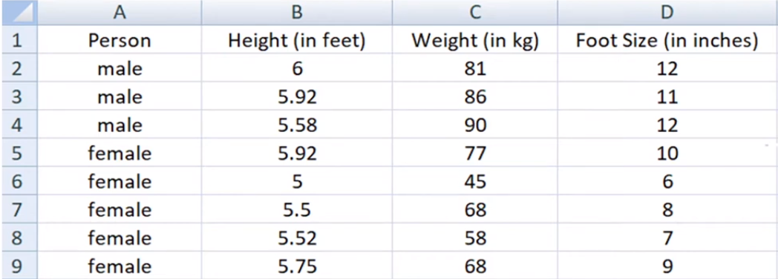

Features:
Properties of the training data are called features.
Labels:
Day-2
Marvel Series

Slide 6
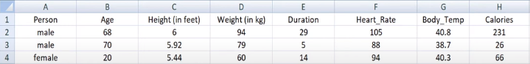

Labels:
Output of a trained model is called label.
Features:
Day-2
Marvel Series

Slide 7
Types of ML
Day-2
Marvel Series

Slide 8

Types of ML
Unsupervised Learning
Supervised Learning
Reinforcement
Learning
Semi-Supervised Learning
Day-2
Marvel Series

Slide 9





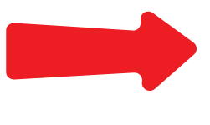

Input
Algorithm
Supervised Learning
Semi-Supervised Learning
Types of ML
Unsupervised Learning:
Training your model on dataset which is not labeled. The model finds the hidden pattern and insights from the given data.
Day-2
Marvel Series
Reinforcement
Learning
Model

Slide 10

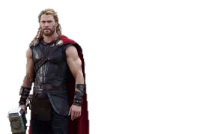
Input
Algorithm
Supervised Learning
Semi-Supervised Learning
Types of Unsupervised Learning
Unsupervised Learning:
Training your model on dataset which is not labeled. The model finds the hidden pattern and insights from the given data.
Clustering
Association
Day-2
Marvel Series
Reinforcement
Learning
Model

Slide 11
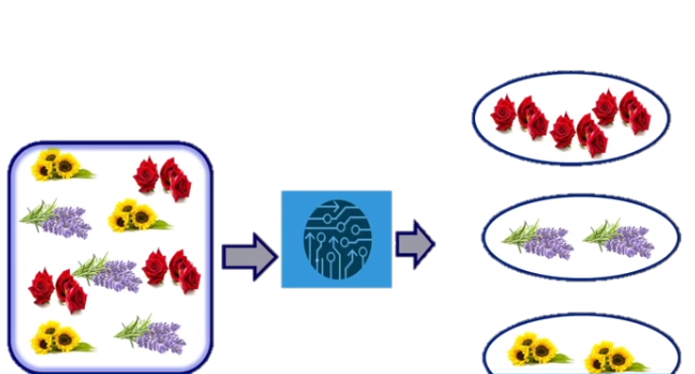
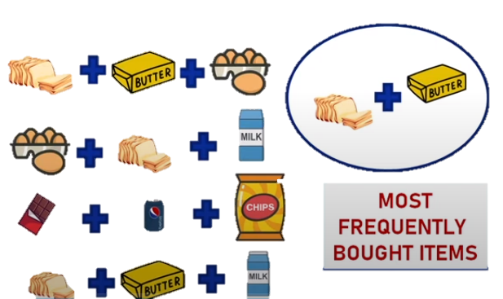
Input
Algorithm
Supervised Learning
Semi-Supervised Learning
Types of Unsupervised Learning
Unsupervised Learning:
Training your model on dataset which is not labeled. The model finds the hidden pattern and insights from the given data.
Clustering
Association
Day-2
Marvel Series
Reinforcement
Learning
Model

Slide 12
Input
Algorithm
Supervised Learning
Semi-Supervised Learning
Types of Unsupervised Learning
Unsupervised Learning:
Training your model on dataset which is not labeled. The model finds the hidden pattern and insights from the given data.
Association
Clustering
Day-2
Marvel Series
Reinforcement
Learning
Model

Slide 13
Unsupervised Learning
Working
Output
Input
It is used for more complex types.
Helpful for finding patterns in data.
Algorithm
Saves lot of manual work and expenses.
Model
Day-2
Marvel Series

Slide 14

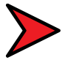
Supervised Learning
Semi-Supervised Learning
Types of ML
Unsupervised Learning
Advantages
It is used for more complex types.
Helpful for finding patterns in data.
Saves lot of manual work and expenses.
Day-2
Marvel Series
Output
Input
Reinforcement
Learning
Model
Algorithm

Slide 15
Supervised Learning
Semi-Supervised Learning
Types of ML
Unsupervised Learning
Disadvantages
Less accuracy.
Time Consuming.
More the features more the complexity.
Day-2
Marvel Series
Output
Input
Reinforcement
Learning
Model
Algorithm

Slide 16
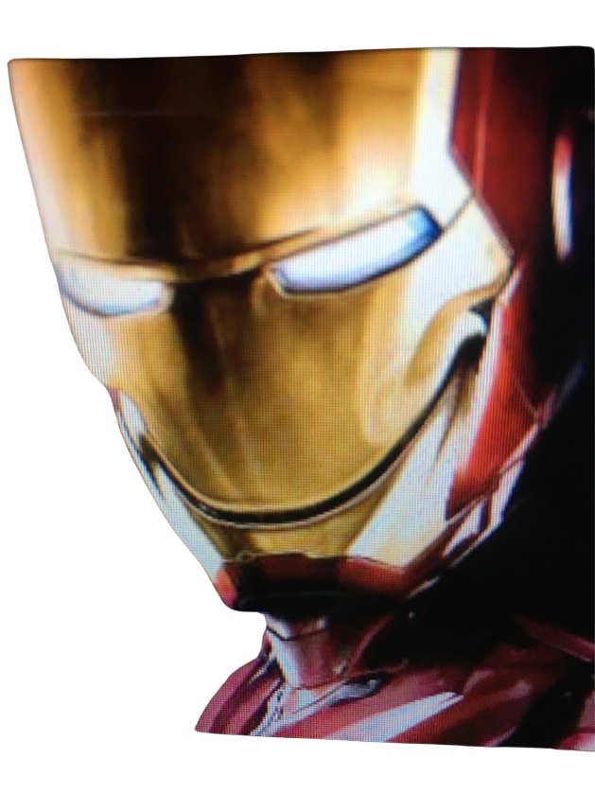
Training your model on dataset which is not labeled. The model finds the hidden pattern and insights from the given data.
Types of ML
Unsupervised Learning
Supervised Learning
Reinforcement
Learning
Semi-Supervised Learning
Day-2
Marvel Series

Slide 17

Input
Algorithm
Supervised Learning
Semi-Supervised Learning
Decision Tree
Types of ML
Random Forest
Regression
Classification
Supervised Learning:
Training your model on dataset which is not labeled. Some inputs are already tagged with correct answers and algorithm learns from labeled data and predict outcomes.
Logistic Regression
Support Vector Machines
Day-2
Marvel Series
Polynomial Regression
Regression
Tress
Logistic
Regression
Reinforcement
Learning
Model

Slide 18
Input
Algorithm
Supervised Learning
Semi-Supervised Learning
Types of Unsupervised Learning
Unsupervised Learning:
Training your model on dataset which is not labeled. The model finds the hidden pattern and insights from the given data.
Regression
Classification
Logistic Regression
Polynomial Regression
Regression
Tress
Random Forest
Decision Tree
Logistic
Regression
Support Vector Machines
Day-2
Marvel Series
Reinforcement
Learning
Model

Slide 19
Supervised Learning
Working
Output
Input
It is used for more complex types.
Helpful for finding patterns in data.
Algorithm
Saves lot of manual work and expenses.
Model
Day-2
Marvel Series

Slide 20
Supervised Learning
Semi-Supervised Learning
Types of ML
Supervised Learning
Advantages
Full control over what machine is learning.
Easily test & debug model.
You can determine the number of classes.
Day-2
Marvel Series
Output
Input
Reinforcement
Learning
Model
Algorithm

Slide 21
Supervised Learning
Semi-Supervised Learning
Types of ML
Unsupervised Learning
Disadvantages
Have limited scope.
Collection of dataset is difficult.
Wrong prediction.
Day-2
Marvel Series
Output
Input
Reinforcement
Learning
Model
Algorithm

Slide 22
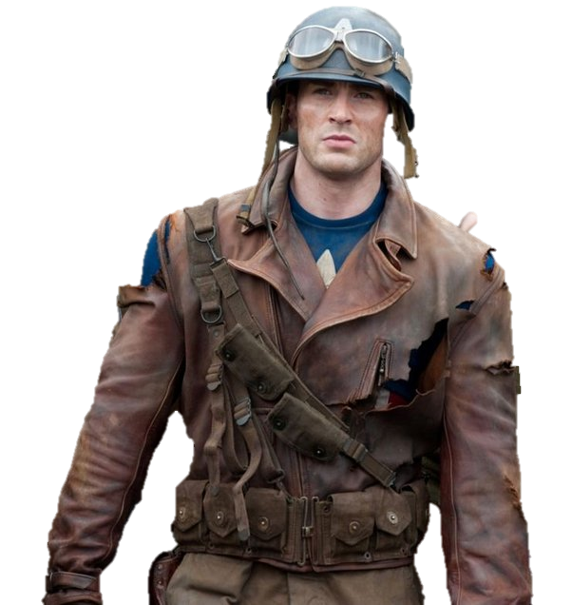

Input
Algorithm
Supervised Learning
Semi-Supervised Learning
Unsupervised Learning:
Training Data
Testing Data
Training your model on dataset which is not labeled. The model finds the hidden pattern and insights from the given data.
*Model
*Model
Day-2
Marvel Series
Reinforcement
Learning
Model

Slide 23

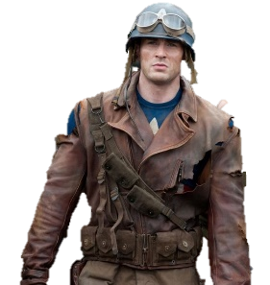
Input
Algorithm
Supervised Learning
Semi-Supervised Learning
Unsupervised Learning:
Training Data
Training your model on dataset which is not labeled. The model finds the hidden pattern and insights from the given data.
Data used for training your model. It is a part of your whole data. The data partition depends on developer but usually it is 80/20. Where 80% is the training data.
Testing Data
Day-2
Marvel Series
Reinforcement
Learning
Model

Slide 24

Input
Algorithm
Supervised Learning
Semi-Supervised Learning
Unsupervised Learning:
Testing Data
Training your model on dataset which is not labeled. The model finds the hidden pattern and insights from the given data.
Data used after training your model to test the learning of your model. It is unseen data for the model and usually compromises of 20% of original data.
Training Data
Day-2
Marvel Series
Reinforcement
Learning
Model

Slide 25
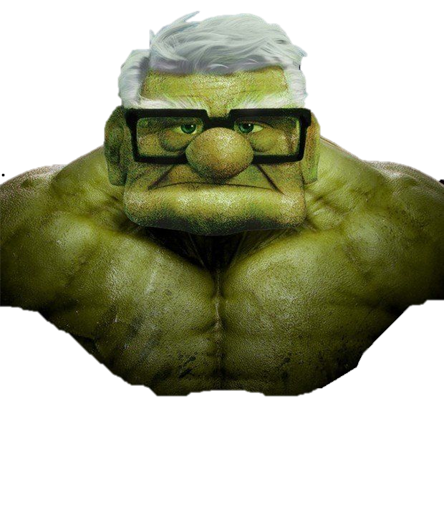
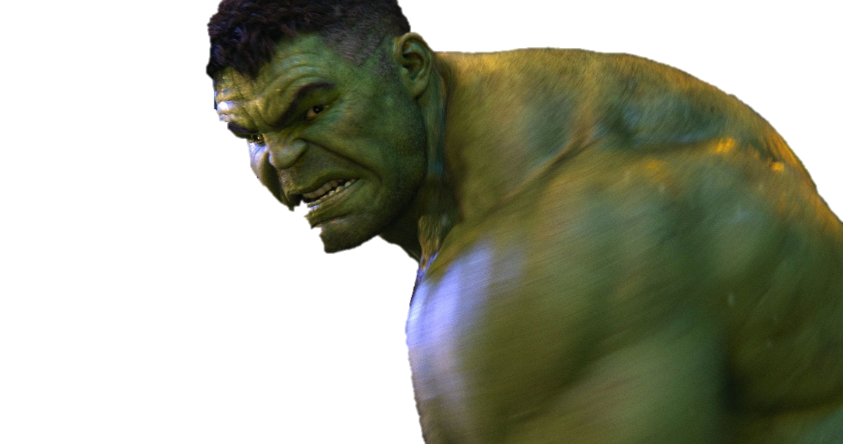
Kaggle: https://Kaggle.com
Amazon: https:// registry.opendata.aws
UCI Repo: https://archieve.ics.ui.edu/ml/index.php
Microsoft: https://msropendata.com
Government Dataset
Workshop Time
Let’s Code
Let’s Go
Training & Testing Data
Day-1
Marvel Series
Awesome Repo: https://github.com/awesomedata/awesome-public-datasets
Scikit learn: https://scikit-learn.org/stable/
Computer Vision : https://www.visualdata.io/discovery
Google’s Data

Slide 26



Input
Algorithm
Supervised Learning
Semi-Supervised Learning
Testing Data
Unsupervised Learning:
Training your model on dataset which is not labeled. The model finds the hidden pattern and insights from the given data.
Overfit Model
Underfit Model
Data used after training your model to test the learning of your model. It is unseen data for the model and usually compromises of 20% of original data.
Day-2
Marvel Series
Training Data
Reinforcement
Learning
Model

Slide 27
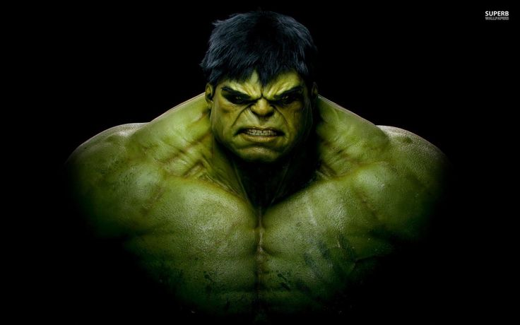
Input
Algorithm
Supervised Learning
Overfit Model
Semi-Supervised Learning
Testing Data
Unsupervised Learning:
Any Questions?
Training your model on dataset which is not labeled. The model finds the hidden pattern and insights from the given data.
Data used after training your model to test the learning of your model. It is unseen data for the model and usually compromises of 20% of original data.
Day-2
Marvel Series
Training Data
Reinforcement
Learning
Underfit Model
Model

Slide 28
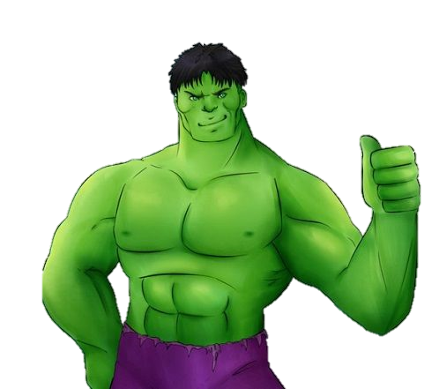
Input
Algorithm
Supervised Learning
Overfit Model
Semi-Supervised Learning
Testing Data
Unsupervised Learning:
Thank You
Data used after training your model to test the learning of your model. It is unseen data for the model and usually compromises of 20% of original data.
Come again with Day-3
Day-2
Marvel Series
Training Data
Reinforcement
Learning
Underfit Model
Model

Slide 29

Input
Algorithm
Supervised Learning
Overfit Model
Semi-Supervised Learning
Testing Data
Unsupervised Learning:
Thank You
Data used after training your model to test the learning of your model. It is unseen data for the model and usually compromises of 20% of original data.
Come again with Day-3
Day-2
Marvel Series
Training Data
Reinforcement
Learning
Underfit Model
Model

